Slide 1


The Satellite Needs Working Group – overview and status update
May 2, 2023
Pontus Olofsson
pontus.olofsson@nasa.gov
NASA Marshall Space Flight Center

Slide 2
Goal of the Satellite Needs
Working Group (SNWG):
Implement solutions that address Earth observation-needs of federal agencies

Slide 3
STEP 1
NASA develops a survey of the needs of fed. agencies
STEP 9
NASA MSFC collects lessons learned and feedback of how solutions are adopted
STEP 2
The USGS distributes the survey and gathers responses
STEP 8
NASA MSFC manages stakeholder engagement
The SNWG cycle
STEP 3
Responses are vetted by each agency’s senior leadership and sent to USGEO
‘20 cycle
Four solutions
STEP 7
NASA MSFC manages, formulates, and, reviews implementation of funded solutions
STEP 4
‘22 cycle; ROMs requested for 8 solutions
NASA, USGS, NOAA assess submission and formulates a set of solutions
STEP 6
STEP 5
NASA HQ identifies and selects implementation teams
Congress appropriates funds for a subset of solutions prioritized by the Exec. Branch

Slide 4
All SNWG Solutions: https://www.earthdata.nasa.gov/esds/impact/snwg/solutions
HIGHLIGHTS:
2016 cycle:
Harmonized Landsat Sentinel-2 (HLS) surface reflectance products
Catalog of Archived Suborbital Earth Science Investigations (CASEI)
2018 cycle:
ICESat-2 quicklook products
Observational Products for End-Users from Remote Sensing Analysis (OPERA)
2020 cycle:
TEMPO near real-time products
HLS-derived vegetation indices
Expansion of Pandora air quality network and air quality forecasts
Merged atmospheric sounder/GNSS planetary boundary layer product
Assessment needs submitted in the 2022 cycle in progress; a full list of SNWG activities being implemented is available here.

Slide 5
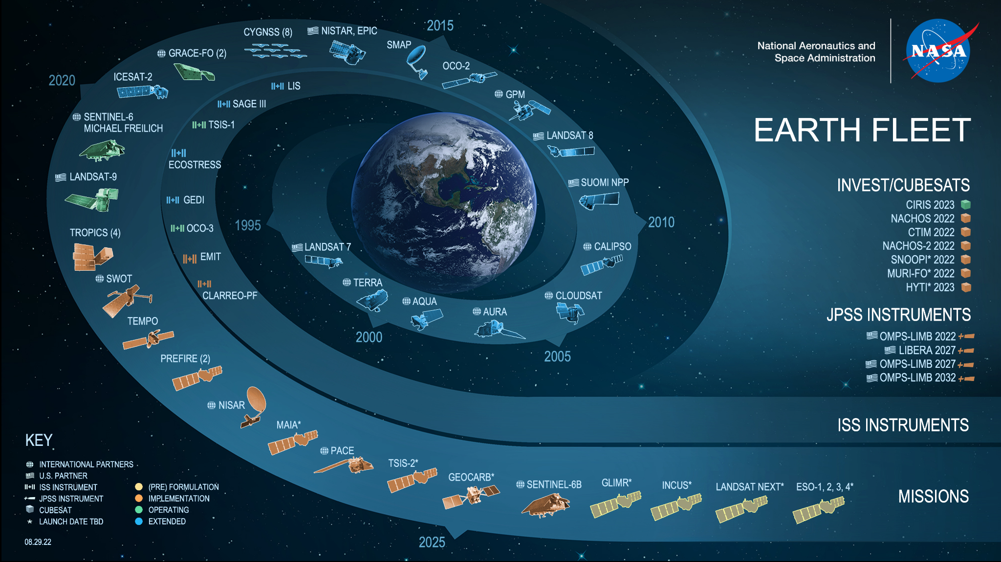
Needs Assessment
Online interviews conducted for each need (117 for ‘22 cycle!)
Time-consuming but essential for understanding how to address needs
Explosion of missions, data, and products!

Slide 6
Stakeholder Engagement
NASA JPL 2018 cycle (OPERA); NASA MSFC 2020 cycle onwards
Aim: ensure stakeholder capacity sufficient to adopt solutions
Solutions vary in specificity and coverage => stakeholder engagement vary per solution
Fosters NASA’s Open Source Science Initiative

Slide 7
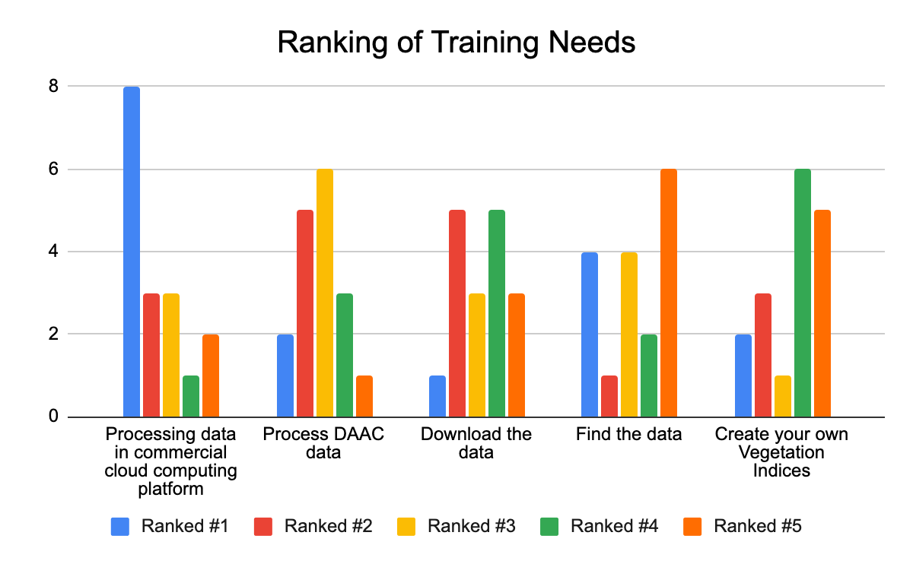
Stakeholder Engagement

Slide 8

Thank you.

